Slide 1

To our Project Report

Slide 2
Project Name :
Online mobile banking Management system
Course Code : CSE - 325
Course Title : System Analysis & Design
Submitted To : Supta Richard Philip
City University , Bangladesh
Group- 08
Name ID
1. MD.Amran Hossen 171442528
2. Md. Sheikh Farid 171442534
3. Md Manirul Islam 171442618

Slide 3

: Definition of Mobile Banking
"Mobile Banking refers to provision and availment of banking- and financial services with the help of mobile telecommunication devices.

Slide 4
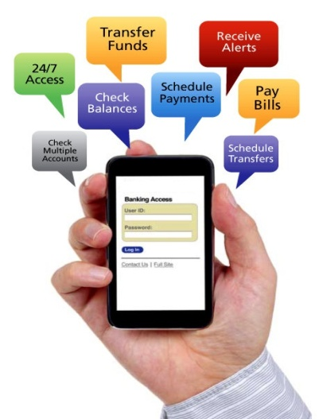
Related Project
Bkash By Brac Bank.
Rocket By DBBL.

Slide 5
Advantage & Disadvantage of Mobile Banking
Advantages | Disadvantage
Easy of Availability any time ,any where | Security Concerns About the new channel
Simple To use | Restricted Scope
Transmitted data are secured | Mobile Handset operability
Rapid growth of mobile and wireless Market | Application Distribution
No need to go For bank Branch | Non uniformity of services
can easily monitor your account – you can check your transfers, transaction history, deposits etc | Risk of unofficial mobile application

Slide 6
Functional And non-Functional
Some typical non-functional requirements are:
Scalability
Capacity
Availability
Reliability
Recoverability
Some of the more typical functional requirements include:
Business Rules
Transaction corrections, adjustments and cancellations
Administrative functions
Authentication
Authorization levels
Audit Tracking

Slide 7
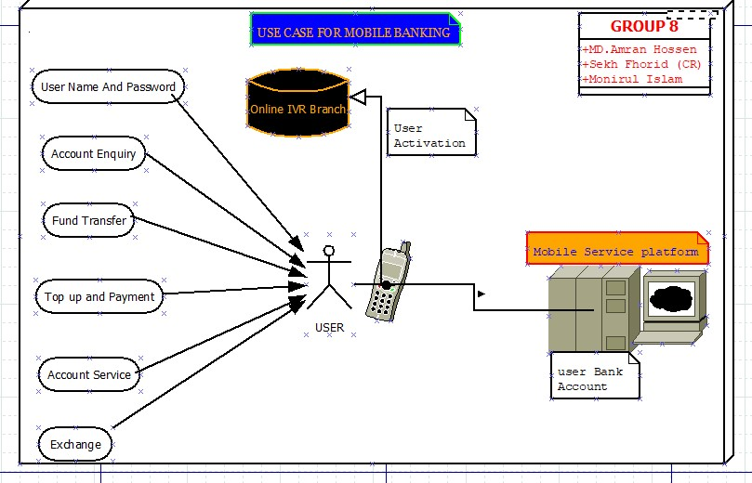
Use case

Slide 8
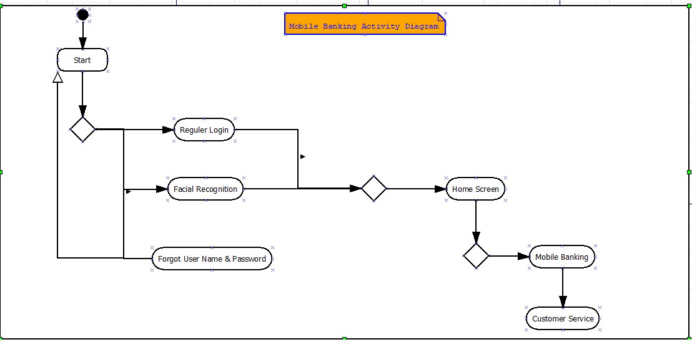
Activity
Diagram

Slide 9
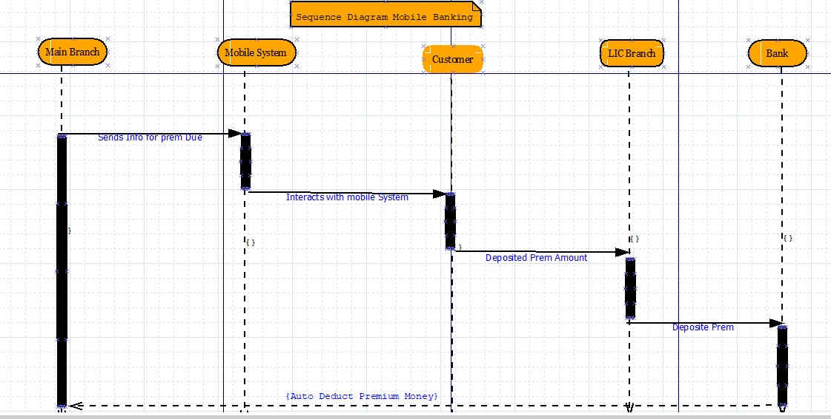
Sequence Diagram

Slide 10
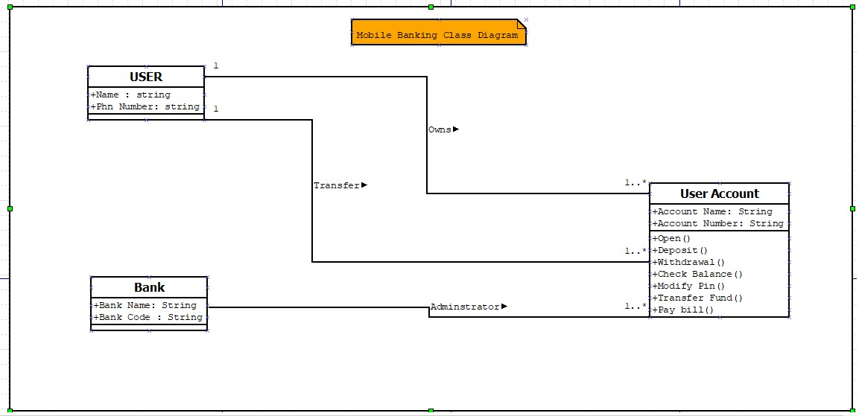
Class Diagram

Slide 11
Conclusion
In conclusion, mobile banking has its potential to develop in Malaysia. From this chapter, we can know the factors that will affect the customers’ perception toward mobile banking. Besides, the problem statement and research objective also will be determined. We also can know the scope and key assumptions of this research so that we can determine the area of this study.

Slide 12


